Slide 1
16 Feb 21 -> 23 Feb 21
Just like last week, but better

Slide 2
Overview
Qbot2 Update
Conference Acceptance
Re-accomplished PSD for VRW/ARW
IMU Error Contribution Comparison
Fake Aiding Sensor Implemented
Looking Ahead

Slide 3
Qbot2 Update
It seems the Qbot2 breakout board has kicked the bucket. This is why it wouldn’t connect to the router.
Dr. Bruder has mailed out a new breakout board, hopefully this will resolve the issue.
I need to send in the broken board into Quanser in Ontario, Canada. Quanser doesn’t seem to want to pay for the shipping. Who should cover the bill?..

Slide 4

Conference Acceptance

Slide 5
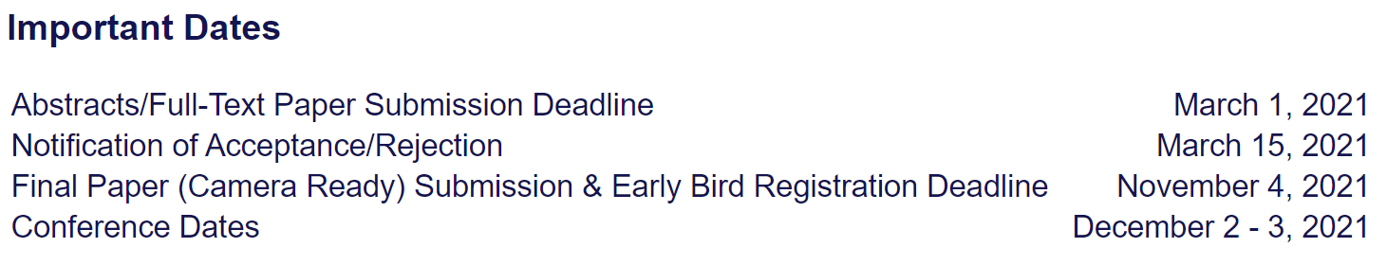
Conference – Important Dates
I’m going to build a schedule laying out goals we should reach to ensure our final paper is ready to go on November 4th.
Any thoughts?

Slide 6
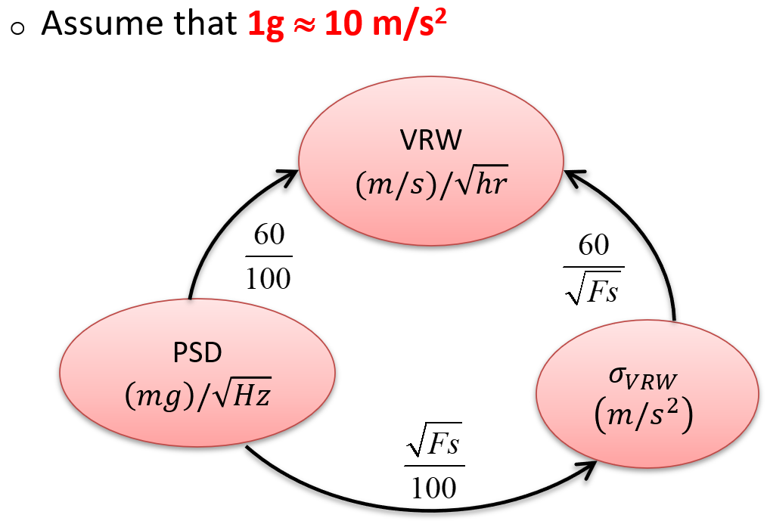
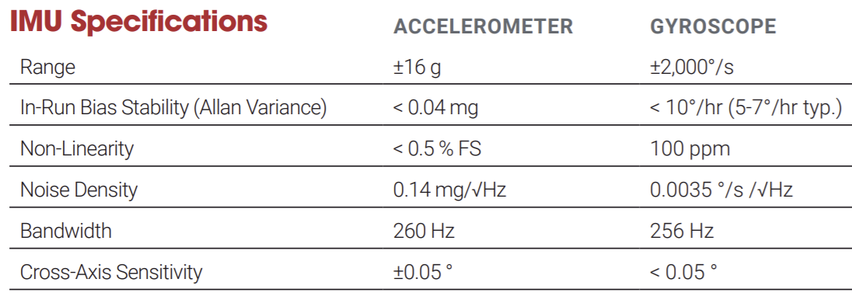
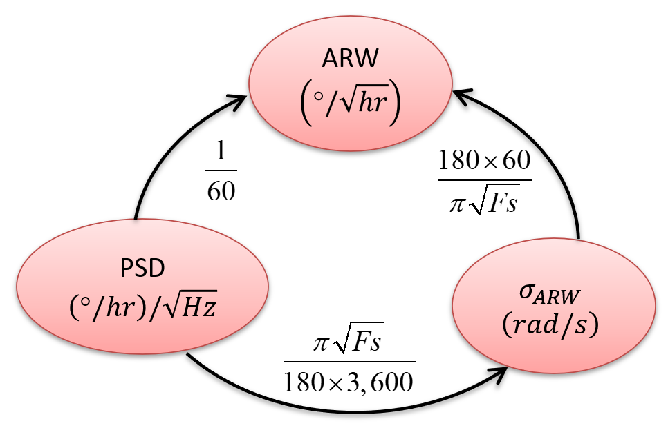


Expected VRW/ARW
From Vector-Nav VN200 Datasheet
$$VRW= \frac{0.14 mg}{\sqrt{Hz}} ∙ \frac{60}{100}=0.084 \frac{m/s}{\sqrt{hr}}$$
$$ARW= \frac{0.0035 \frac{°}{s}}{\sqrt{Hz}} ∙ \frac{3600}{60}=0.21 \frac{°}{\sqrt{hr}}$$

Slide 7
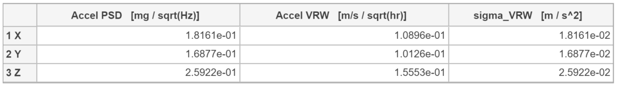

PSD for VRW
$$VRW= \frac{0.14 mg}{\sqrt{Hz}} ∙ \frac{60}{100}=0.084 \frac{m/s}{\sqrt{hr}}$$

Slide 8
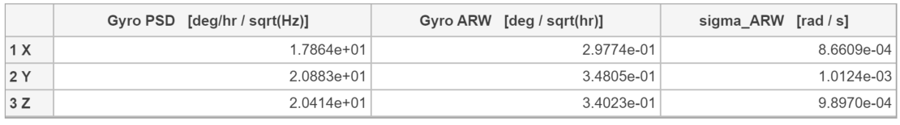

PSD for ARW
$$ARW= \frac{0.0035 \frac{°}{s}}{\sqrt{Hz}} ∙ \frac{3600}{60}=0.21 \frac{°}{\sqrt{hr}}$$

Slide 9
IMU Error Contribution Comparison
I accomplished an analysis of IMU Error Propagation. It’s a cruder approximation, however it does a great job illustrating the problem we are tackling.
See the live script created for this instance:
Results are in that live script, because I have some questions…

Slide 10
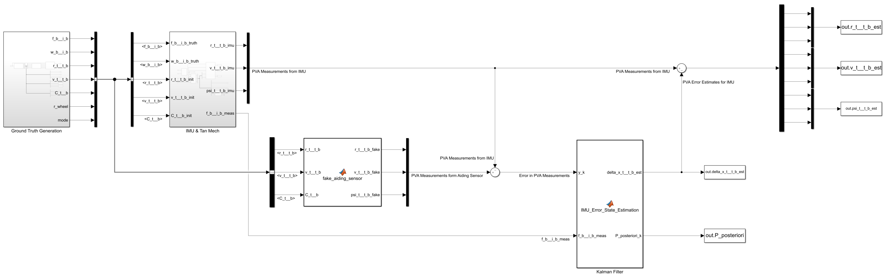
Fake Aiding Sensor Implementation
Assumed IMU is calibrated.
No fixed bias, bias stability, scale factor, misalignment, or gyro sensitivity
White Noise and Bias Instability are present

Slide 11
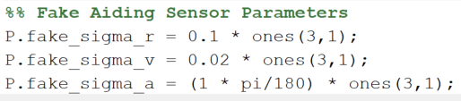
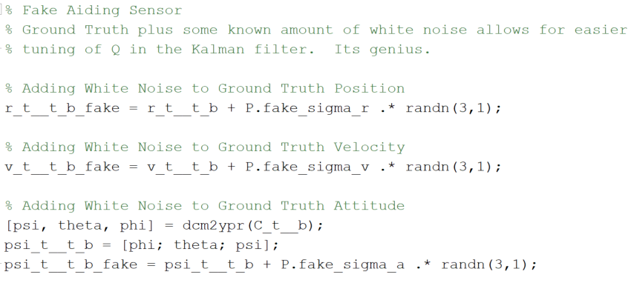
Fake Aiding Sensor Implementation
Ground Truth PVA are fed into the Fake Aiding Sensor, white noise with known sigma is added, and is fed to the Kalman filter.
This allows for perfect reconstruction of “R” as well.

Slide 12
Fake Aiding Sensor Validation
Fake Aiding Sensor is Providing Expected Outputs

Slide 13
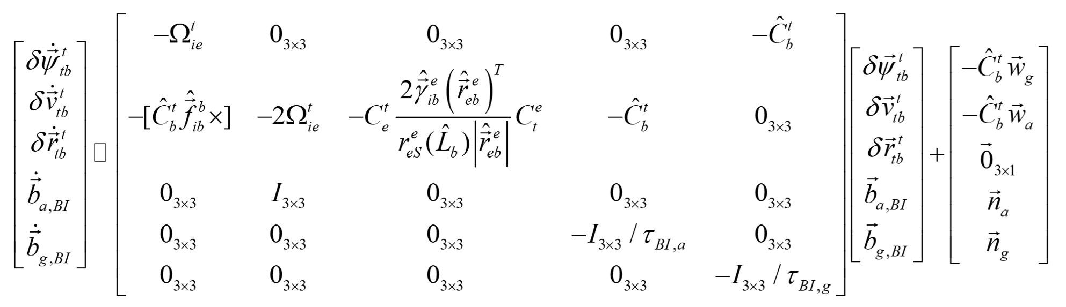
Fake Aiding Sensor – Tuning Q
Theoretically, what should Q be?
Process Model shown below.

Slide 14
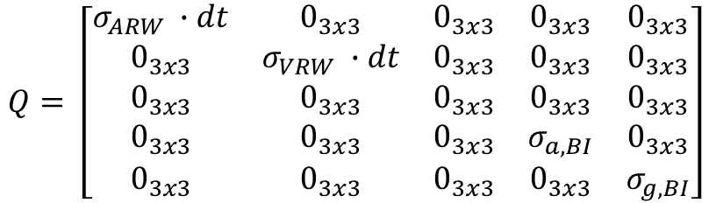

Tuning Q
$$Q=E(w\left(k\right)w^{T}\left(k\right))$$
$$Q= \left[\begin{matrix}σ_{ARW} ∙dt & 0_{3x3} & 0_{3x3} & 0_{3x3} & 0_{3x3} \\ 0_{3x3} & σ_{VRW} ∙dt & 0_{3x3} & 0_{3x3} & 0_{3x3} \\ 0_{3x3} & 0_{3x3} & 0_{3x3} & 0_{3x3} & 0_{3x3} \\ 0_{3x3} & 0_{3x3} & 0_{3x3} & σ_{a,BI} & 0_{3x3} \\ 0_{3x3} & 0_{3x3} & 0_{3x3} & 0_{3x3} & σ_{g,BI}\end{matrix}\right]$$

Slide 15
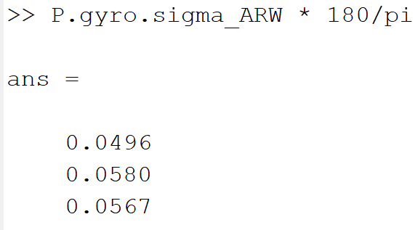
Fake Aiding Sensor Performance
Attitude Estimation seems somewhat tuned
Doesn’t deviate, covariance settled to R value mostly it seems

Slide 16
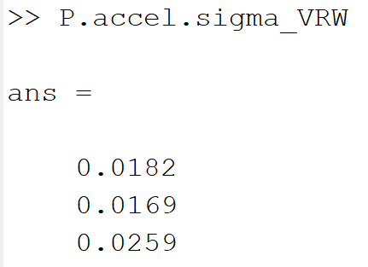
Fake Aiding Sensor Performance
Velocity Estimates are Drifting
I have no idea why

Slide 17
Fake Aiding Sensor Performance
Position also experiences some serious drift
I’d cheer if this were the odometry sensor, but its ground truth
There must still be a serious flaw somewhere

Slide 18
Fake Aiding Sensor Truth vs. Estimates
The drift should be clear. This is a problem given we are feeding in ground truth into the measurements.
I could use some guidance stepping through this Kalman filter implementation and locating some misunderstandings

Slide 19
Looking Ahead
I’ll be underground this Thursday to next Thursday
It’s a great time to get lots of writing and documentation done
Writing the IMU error propagation section would be time well spent this week
I can still debug code on the few days I’m above ground
Thoughts/Questions/Concerns?

